Slide 1

Note: The data and information in this document is reflective of a hypothetical situation and client. This document is to be used for KPMG Virtual Internship purposes only.
Sprocket Central Pty Ltd
Data analytics approach
[Division Name] - [Engagement Manager], [Senior Consultant], [Junior Consultant]

Slide 2
Note: The data and information in this document is reflective of a hypothetical situation and client. This document is to be used for KPMG Virtual Internship purposes only.
Agenda
Introduction
Data Exploration
Model Development
Interpretation

Slide 3
Note: The data and information in this document is reflective of a hypothetical situation and client. This document is to be used for KPMG Virtual Internship purposes only.
Introduction
Targeted marketing of bikes
Using the existing 3 datasets (Customer demographic, customer address and transactions) as a labelled dataset, the task is to recommend which of these 1000 new customers should be targeted to drive the most value for Sprocket Central Pty Ltd.

Slide 4
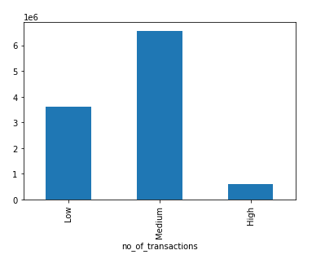
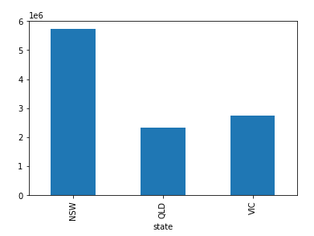
Note: The data and information in this document is reflective of a hypothetical situation and client. This document is to be used for KPMG Virtual Internship purposes only.
Data Exploration
What type of customers contributed most to profit
Male and female contributed equally to profit.
Most of the profit was made through adults.
Customers from financial services and manufacturing sector contributed the most to profit.
Mass customers contributed the most to profit.
Customers from NSW state contributed the most to profit.
Customers who made the last purchase within last 3 months of 2017 are the ones who contributed the most to profit.
Profit
Profit

Slide 5
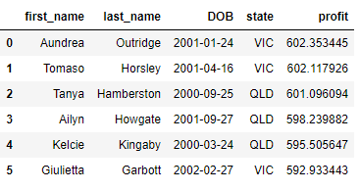
Note: The data and information in this document is reflective of a hypothetical situation and client. This document is to be used for KPMG Virtual Internship purposes only.
Model Development
Predicting profit for new customers using Machine Learning (Regression)
Independent features – gender, job_industry_category, owns_car, state, age, wealth_segment, tenure, property_valuation
Dependent feature – profit (list_price-standard_cost)
Model trained – Random forest regressor

Slide 6
Note: The data and information in this document is reflective of a hypothetical situation and client. This document is to be used for KPMG Virtual Internship purposes only.
Interpretation
Top focus customers
Top 5 customers:
Are from states VIC or QLD.
Are from financial services, manufacturing or IT sectors.
Own car.
Contributed to 600 units profit each.

Slide 7
Note: The data and information in this document is reflective of a hypothetical situation and client. This document is to be used for KPMG Virtual Internship purposes only.
Appendix

